Slide 1
Solar Schools Toolkit October 10, 2023
Philadelphia Solar Energy Association
Supported by: PA Department of Environmental Protection In cooperation with: PHENND, Center for School Study Councils, DVRPC and Generation 180
Notes:
DRAFT

Slide 2
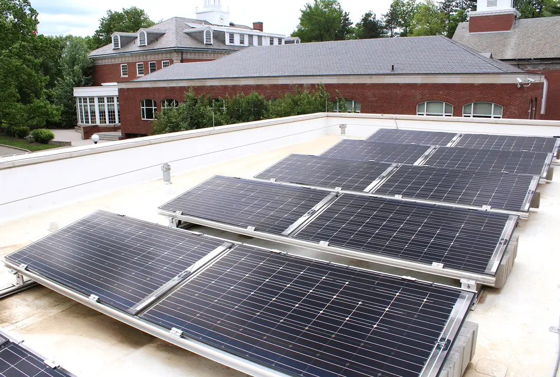
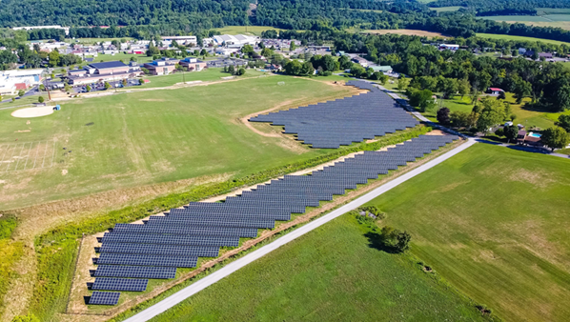
Solar Schools Toolkit
Why Go Solar Now?
10 Steps
Financing
Q&A
Notes:
Dave’s opening remarks

Slide 3
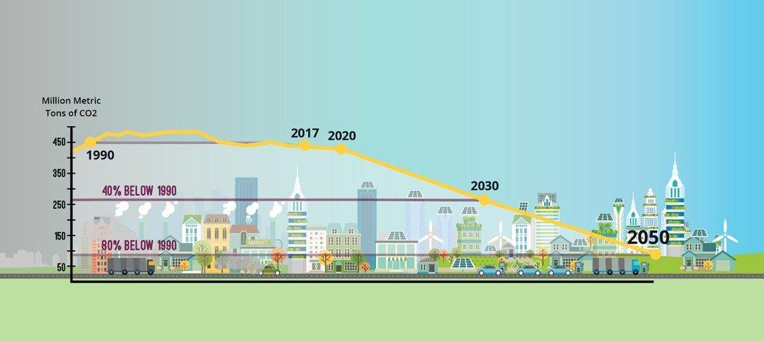
Inflation Reduction Act (IRA) $369 Billion for Climate Action Game changer for Schools and Nonprofits
Notes:
Liz

Slide 4
Investment Tax Credit per the IRA
Solar Investment Tax Credit (ITC) = 30% if the project < 1 MW; or if project > 1MW & meets prevailing wage and apprenticeship rules.
ITC now includes battery storage
10% adder for domestic content (“Buy America”)
10% adder for location in “energy communities” (communities near a brownfield, a closed coal mine or coal power plant, or with employment/tax revenue from fossil fuel operation - most of PA
10% competitive adder for location in a low-income census tract
IRS has issued guidance
Notes:
Liz

Slide 5
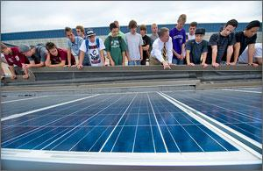
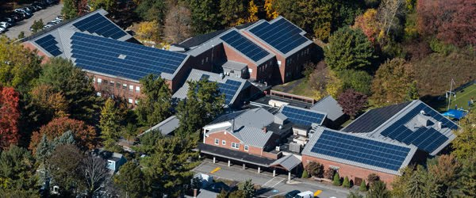
Tax-exempt entities are included!
For schools, government entities, non-profit organizations, and rural electric co-ops, the ITC is available as an elective payment (i.e. IRS will send you a check) in lieu of a tax credit.
Notes:
Liz

Slide 6
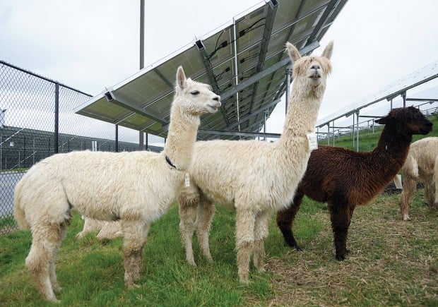
Advantages of Going Solar
Energy Bill Savings
Offset electricity consumption
Reduce peak
Earn Solar Renewable Energy Credits
Improve Resilience
Reduce CO2 emissions
Help meet local, state & nat’l goals
Increase stability of energy costs
Avoid future rate hikes
Create educational opportunities for students and staff
Strengthen STEM education and career readiness
Notes:
Liz

Slide 7
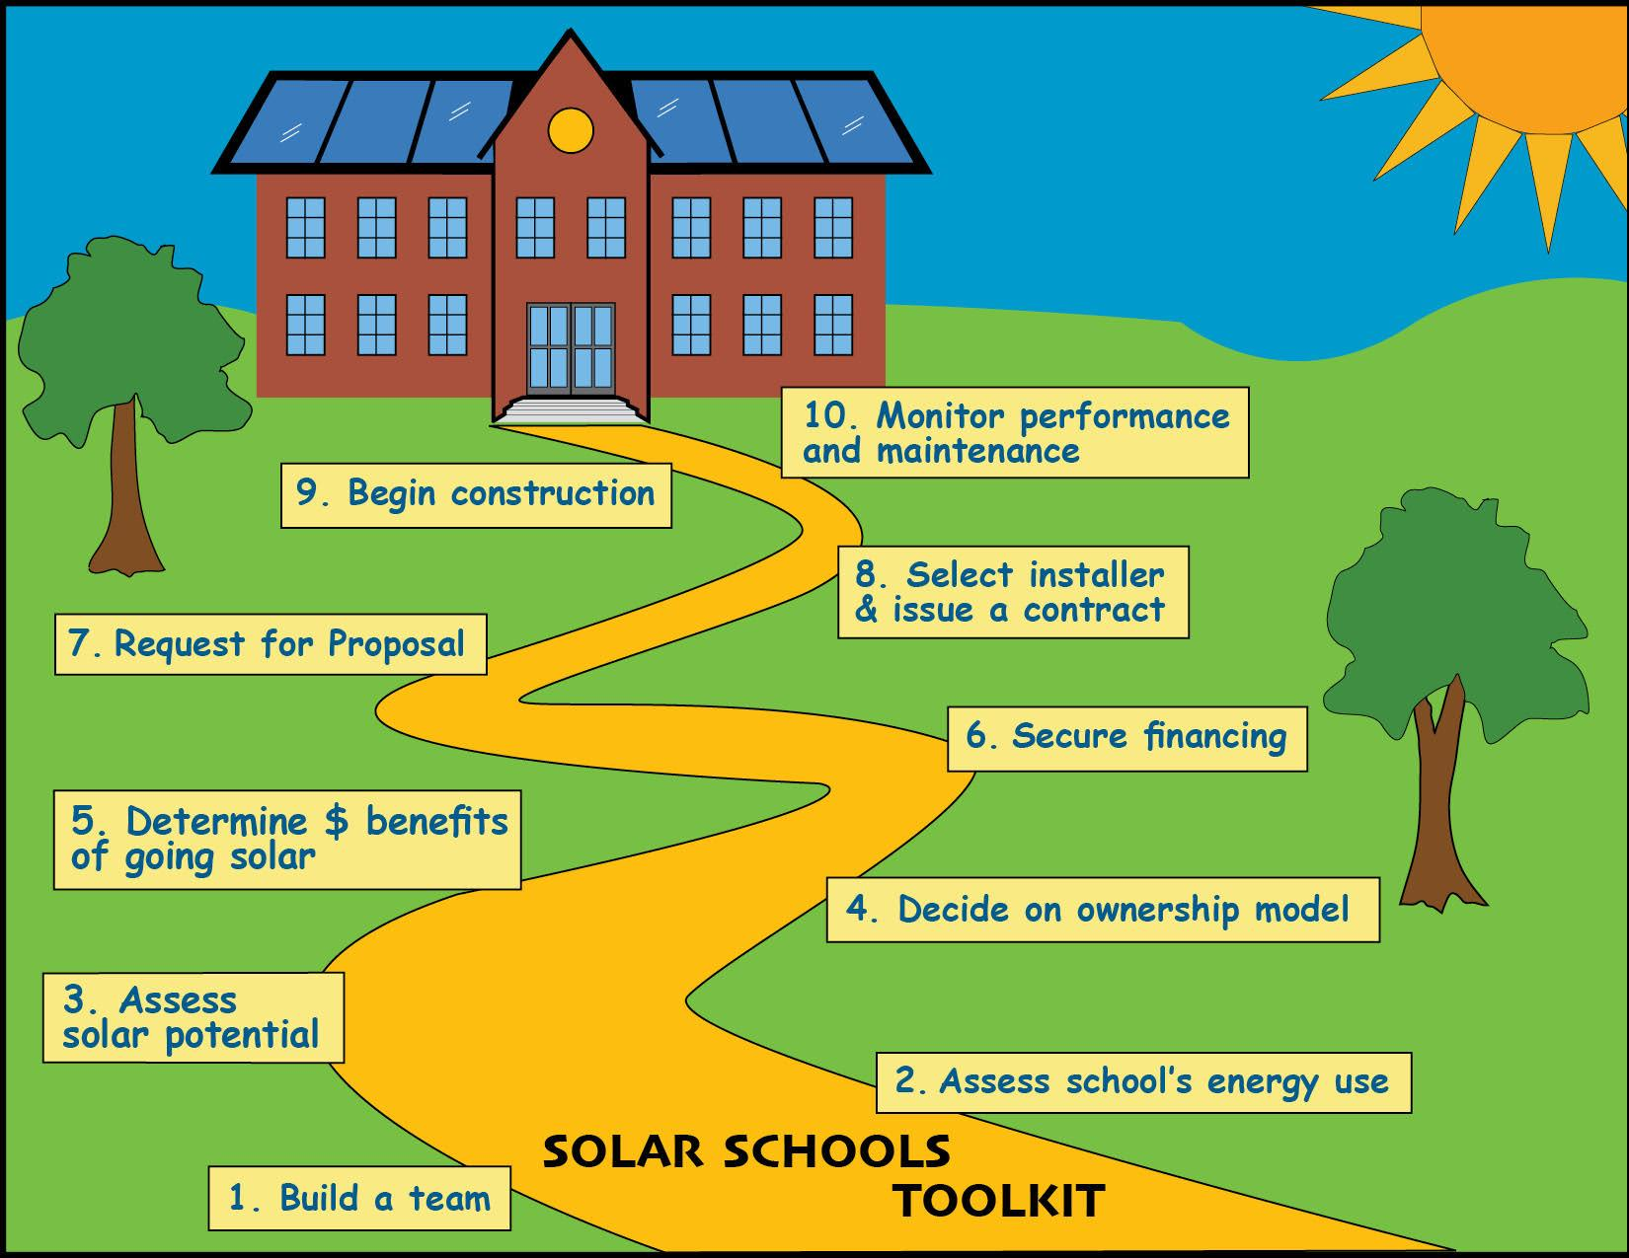
Notes:
Liz

Slide 8
1. Build a Team
If possible, include resources, decision makers and worker bees, e.g.
Facility Manager
Chief Finance Officer
Champions: People committed to getting the project done
Students
Consultants
Notes:
Liz

Slide 9
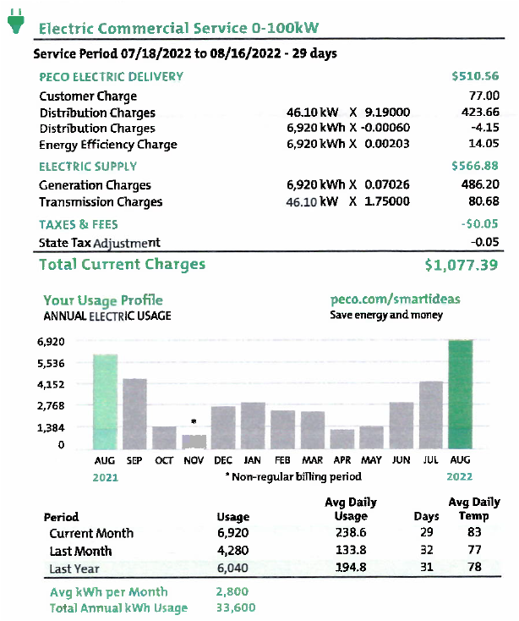
2: Assess your School’s Energy Use
Know your Electric Bill:
Customer charge
Distribution Charges
Monthly Energy Usage - kWh, and rate ($/kWh)
Monthly Peak Demand - kW, and rate ($/kW)
Supply Charges (third party supplier - EGS )
Monthly Energy Usage - kWh, and rate ($/kWh)
Monthly Peak Demand - kW, and rate ($/kW)
Annual Electric Usage (kWh/yr)
Benchmarking: Energy usage, efficiency improvements
Project future uses and costs:
EV buses, Charging stations
Decarbonization
Notes:
Ron

Slide 10
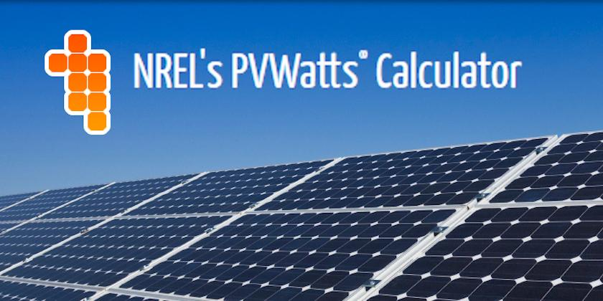
3. Assess School’s Potential for Solar Generation
Final design is the responsibility of the solar installer, but early assessment is worthwhile.
Location of solar array and inverters - roof(s) or ground-mount
Roof conditions - age of roof equipment
Ground conditions - parking lots, available land
Solar access - orientation and shading
Safety - access to system hardware
Interconnection point
Predict solar generation -
PVWatts and other simulation tools
Notes:
Ron

Slide 11
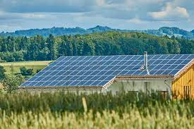
4. Decide your Ownership Model
Direct Ownership
Benefits not shared with a third-party
But you need to: arrange for financing
select the solar installer
maintain the system - O&M contract
Third-Party Ownership
Power Purchase Agreement (PPA); Lease
Toolkit has 2 Proformas to help you decide
which model is best for you.
Notes:
Roger
Two basic ownership models - own it yourself or a third party owns it and host pays for output (a PPA) or for the lease of the equipment
Until now, schools used a third-party ownership structure because schools were ineligible for the tax benefits of the ITC
But with IRA adding Direct Payments for entities exempt from federal income tax, this may well change
Direct Ownership
benefit that you do not need to share the financial benefit with a third-party
but more responsibility (and risk) falls on the direct owner - financing, system maintenance
Third party ownership - many variations possible
PPA
payments based on project output - ¢ per kWh
trade-off between cost savings, duration or term, and buy-out
guarantee of energy savings
Lease
similar to other leases, you are renting the system hardware - payments based not on kWh generated

Slide 12
5. Evaluate the Financial Benefits of Solar
Offset your electricity consumption - kWh
Net metering / virtual meter aggregation
Reduce Demand - kW - probably not significantly
SREC income
O&M expense + finance costs (if direct ownership)
PPA/lease costs (for third-party ownership)
Notes:
Roger
The key issue - will this solar system save us money?
Should be evaluated on the basis of capital and operating costs over the lifetime of the system - cost of PV versus grid power
Toolkit will come with a Pro Forma - an Excel model for evaluating project costs and estimating savings - to allow you to test different assumptions such as future electricity prices, O&M price escalation rates, SREC price and duration, etc. - beware of rosy assumptions
Also do not simple take your annual bill and divide by your total kWh to determine a value of each kWh generated - there is a fixed customer charge and other fees that cannot be avoided.
What are the revenue streams?
Reduced kWhs your school purchases from the utility- net metering determines the value of these kWh (full retail)
Reduced demand - kW - but as Ron explained, it is easy to overestimate demand reduction and its savings
Selling SRECS to EDCs, EGSs or voluntary market.
But revenues are offset by expenses
for direct ownership, these include O&M expense - routine maintenance + equipment replacement if failure; and finance expenses
for PPA/leases - costs under the agreements
Your solar installer / developer will do a final estimate your savings once they have been selected and the system has been designed and priced, but doing your own estimate will help the team decide whether to proceed with the project.

Slide 13
6. Secure Financing for your Solar Project
For Direct Ownership (3rd party is responsible if PPA or lease)
Cash on hand
Grants:
ITC elective payment (30%) + Adders
Utility rebates;
RENEW America’s Schools grants; state grants; others
Public Finance: school bonds, govt. finance programs,
Green Banks, PA Sustainable Energy Funds
4. Private Finance - other lenders
Notes:
Roger
If you are going the Direct Ownership route, you must pay for your system up front - financing.
If you are going the third-party route, all of this slide is the responsibility of the solar developer.
Four main ways to pay for the system
Cash
Grants
Public Finance
Private Finance
Issue of taxable finance or tax-exempt finance - tax-exempt financing will reduce the ITC percentages

Slide 14
The 30% Base Credit
Two threshold requirements:
The project must have have an Alternating Current (“AC”) generating capacity of less than 1 megawatt (“MW_{AC}”); or
For projects 1 MW_{AC} and larger, the project must satisfy prevailing wage and apprenticeship requirements.

Slide 15
Situations that reduce the 30% credit:
If a project is 1MW_{AC} or larger and the solar installer fails to pay prevailing wages for construction or satisfy the apprenticeship requirements, the ITC 30% percentage is reduced to 6%.
If schools (and other tax-exempt entities) finance their project with tax-exempt financing, the 30% ITC is reduced by the lesser of 15% or the percentage of the total project cost that was financed by tax exempt financing.

Slide 16
Process to apply for Elective Pay ITC
Submit pre-filing application on-line through IRS portal – This includes specific information about the nonprofit and the project itself.
IRS reviews application and issues registration number for each project.
Nonprofit then files in the federal tax return (usually the 990) for the elective payment after the system is in place. IRS treats the elective payment as an overpayment of taxes.
IRS processes the request and issues a check for the amount of the ITC.
IRS guidance

Slide 17
30% Base Credit - Key Links
General:
The White House - Clean Energy Updates page - https://www.whitehouse.gov/cleanenergy/clean-energy-updates/
The White House - Building a Clean Energy Economy: A Guidebook To The Inflation Reduction Act’s Investments In Clean Energy And Climate Action - https://www.whitehouse.gov/wp-content/uploads/2022/12/Inflation-Reduction-Act-Guidebook.pdf
Prevailing Wage / Apprenticeship Requirements:
IRS Guidance 2022–61 - Prevailing Wage and Apprenticeship Initial Guidance Under Section 45(b)(6)(B)(ii) and Other Substantially Similar Provisions - https://www.govinfo.gov/content/pkg/FR-2022-11-30/pdf/2022-26108.pdf
PA Department of Labor - Bureau of Labor Law Compliance - Prevailing Wage Projects website - https://www.dli.pa.gov/Individuals/Labor-Management-Relations/llc/prevailing-wage/Pages/default.aspx

Slide 19
RENEW AMERICA’s NONPROFITS
https://www.energy.gov/scep/renew-americas-nonprofits
Grants to improve energy efficiency in nonprofits; Justice 40

Slide 21
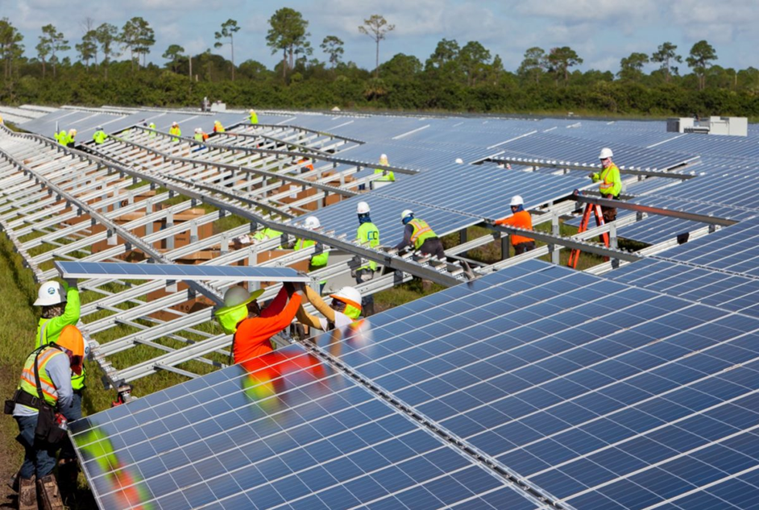
7. Issue a Request for Proposal
Toolkit has a generic RFP
Important elements: Installer qualifications, Experience, References
Consider bidding the project both ways
(Direct ownership and Third-party) to
learn best option
Send RFP to qualified installers
Notes:
Roger
Four reasons for an RFP:
it is required by law
to find the best price
to find a qualified installer
to find the best ideas for your system design, components, etc.
Worthwhile to bid the project both as a direct ownership and as a third-party structure. Not all proposers will bid both ownership models, but you will see how they compare
Important to send the RFP to installers with experience in large systems (as opposed to small residential systems), a crew with training and certification
Toolkit has a generic RFP - schools will need to fill out some specifics for their school and project and maybe add some legal boilerplate required by your school district, but this Word document will allow you to develop a strong RFP that will elicit the information you need to make a wise selection.

Slide 22
8. Select Solar Installer & Issue Contract
Scoring responses to the RFP - what is important to you and the project
What to include in the project contract
What to watch out for in the project contract
Notes:
Roger
Scoring the proposals submitted in response to your RFP is very subjective - different aspects of the bidder and their proposal may be important to you. But the generic RFP suggests a scoring rebrick
Once the solar installer or solar developer is selected, the next task is to execute various project agreements with them. Installers and developers will provide the initial draft, but push back on important points.
This Step in the Toolkit identifies issues that you want included in the agreements - and things to watch out for in the agreements. This is done for both Direct Ownership and Third-Party Ownership projects.
We do not have time to go through these issues today, but they are in the Toolkit.

Slide 23
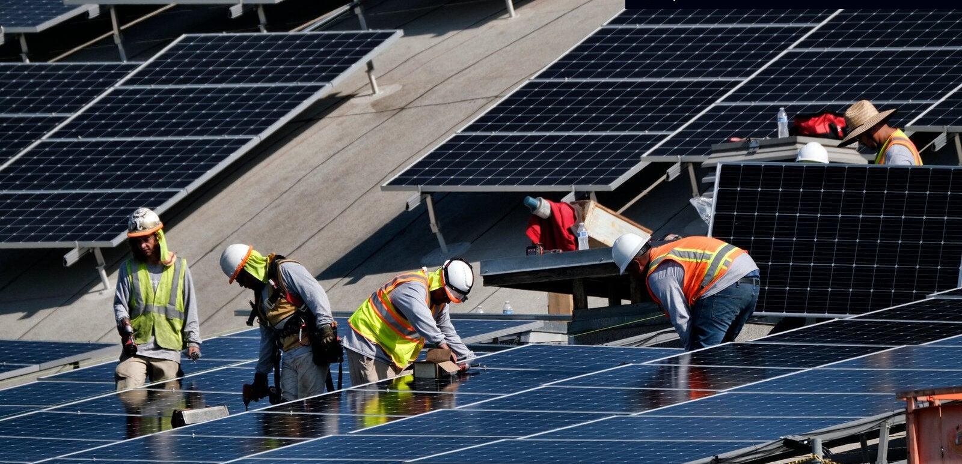
9. Oversee Construction and Installation
Importance of regular communication - Facilities Manager
Contract deliverables / milestones:
system design
equipment selection
interconnection approval
permits
construction
commissioning
inspection
Permission to Operate (PTO)
Notes:
Ron

Slide 24
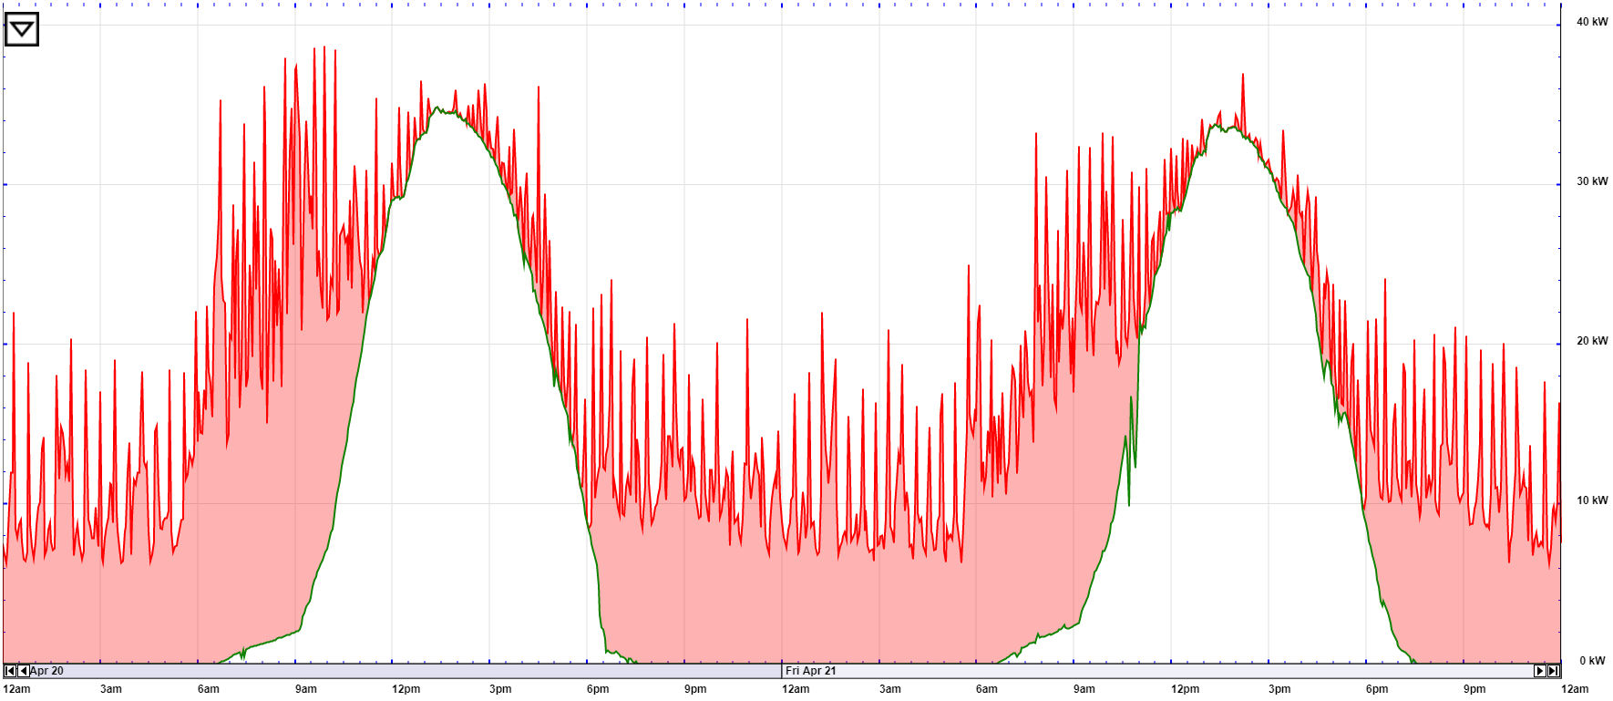
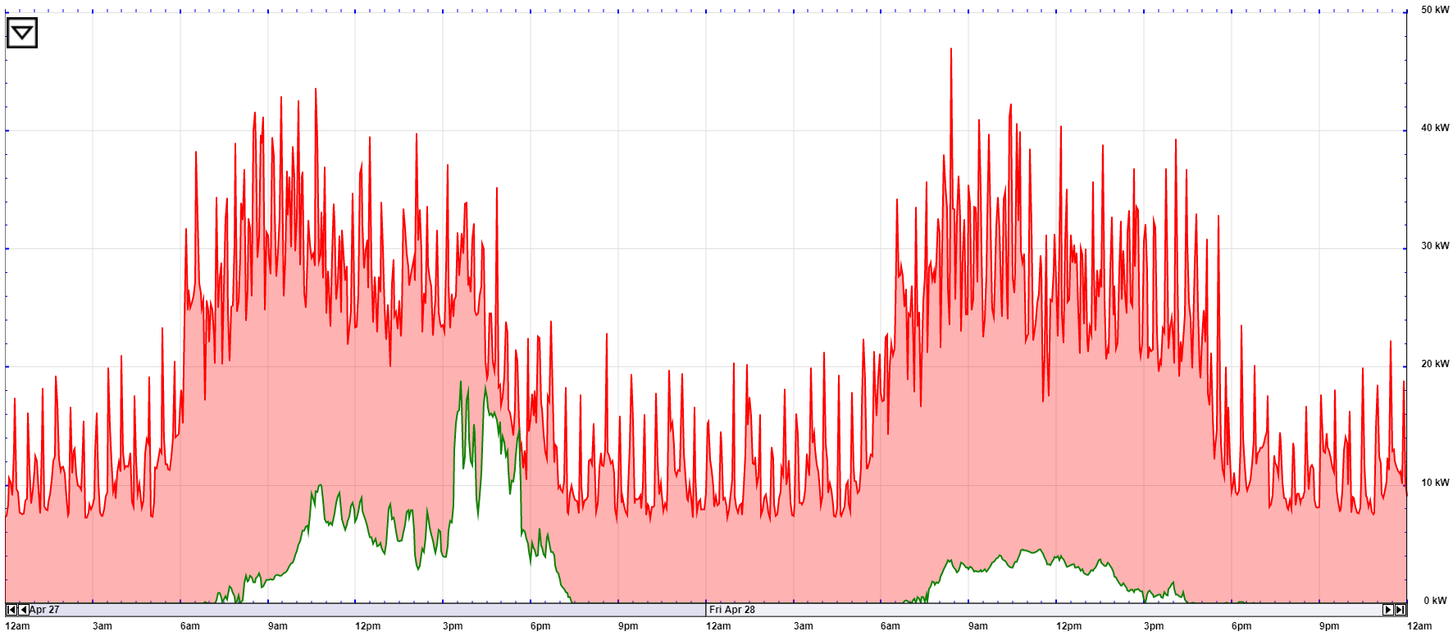
10. Monitor Performance and Maintenance
Monitoring performance - paying attention to output
O&M contract
Inverter replacement - 10-12 years
Using data for STEM education
Notes:
Ron

Slide 25
Questions & Discussion
Liz Robinson
Executive Director
Philadelphia Solar Energy Association
lizhrob2@gmail.com

